Slide 1
Use R to determine if a Tweet was negative, neutral, or positive. The tweets chosen were those about Donald Trump, Mother Teresa, and Barack Obama
Using “R”

Slide 2
#Load necessary packages
Call the needed R packages.
Code:
library(twitteR)
library(ROAuth)
library(tidyverse)
library(purrrlyr)
library(text2vec)
library(caret)
library(glmnet)
library(ggrepel)
library(readr)

Slide 3
#Library for database connection
Load library to connect to SQL Server as specified in the DSN. There can be many simultaneous connections.
Code:
library(RODBC)

Slide 4
#Get data for Mother Teresa, Donald Trump, and Barack Obama
Get 3,000 rows of data from Twitter for Mother Teresa, Donald Trump, and Barack Obama. Insert the data into csv files then insert the data into SQL Server with SSIS. Remove all columns except Ids, texts, dates, and names.
Code:
MotherTeresa <- twListToDF(searchTwitter('mother teresa', n = 3000, lang = 'en')) %>% dmap_at('text', doConversion)

Slide 5
#Convert symbols (latin1) to (ASCII) with iconv
“Iconv” uses system facilities to convert characters between vector encodings. The ‘i’ stands for internationalization.
On systems that supports R’s iconv, you can use “latin1” for encoding the current locale.
Code:
doConversion <- function(x) iconv(x, "latin1", "ASCII", "")

Slide 6
#Load tweets with column names, using read_csv from the readr package (part of tidyverse pkg)
Package readr provides an easy way to read tabular data such as cvs, fwf and tsv. Designed to flexibly parse flat file, readr gives more convenient output by never converting strings to factors, parse date/times and never manipulating column names. It will also cleanly fail when data unexpectedly changes.
Code:
readTwitterData <- read_csv('TrainingData.csv', col_names = c('opinion', 'userno', 'datetime', 'alias', 'diction')) %>%. http://help.sentiment140.com/for-students/

Slide 7
#Convert symbols, switch class values, use mutate to keep existing 0 or add 1, then return a data frame with dmap_at
Code:
dmap_at('diction', doConversion) %>% mutate(opinion = ifelse(opinion == 0, 0, 1))

Slide 8
#Enable repeatable results with set.seed. Split and train data set with createDataPartition
Set.seed is a random number generator that allows you to reproduce results by using previously generated numbers.
createDataPartition is used to create balanced splits to the data.
Code:
set.seed(42)
startTraining <- createDataPartition(readTwitterData$opinion, p = 0.8, list = FALSE, times = 1)
trainTwitterFeeds <- readTwitterData[startTraining, ]
checkTwitterDatum <- readTwitterData[-startTraining, ]

Slide 9
#Convert to lower case with tolower. First pass process and clean up.
Use tokenizer to process vector from preprocessor, then split into tokens. Iterate with itoken to create DTM. Show progress bar.
Code:
startWork <- tolower
simpleTokenizer <- word_tokenizer
trainSet <- itoken(trainTwitterFeeds$diction, preprocessor = startWork, tokenizer =
simpleTokenizer, empnum = trainTwitterFeeds$userno, progressbar = TRUE)
checkSet <- itoken(checkTwitterDatum$diction, preprocessor = startWork, tokenizer =
simpleTokenizer, empnum = checkTwitterDatum$userno, progressbar = TRUE)

Slide 10
#Build dictionary of terms with create_vocabulary.
Define with vocab_vectorizer how to map the word to indices. Create_dtm creates the DTM (Document Term Matrix)
Code:
dictionary <- create_vocabulary(trainSet)
dictionaryVector <- vocab_vectorizer(dictionary)
docTermMatrixTraining <- create_dtm(trainSet, dictionaryVector)
docTermMatrixChecking <- create_dtm(checkSet, dictionaryVector)

Slide 11
#tf-idf modelling by term-frequency and inverse-document-frequency
Used to align the model
Code:
modelTfidf <- TfIdf$new()

Slide 12
#Align the data model to the set that was trained with fit_transform.
Change the trained data with the model.
Codes:
docTermMatrixTraining_modelTfidf<- fit_transform(docTermMatrixTraining, modelTfidf)
docTermMatrixChecking_modelTfidf<- fit_transform(docTermMatrixChecking, modelTfidf)

Slide 13
#Train the model and use k-fold cross validation with cv.glmnet.
Check under the ROC curve. Use nfolds = 5 for faster training. Set maxit = 1e3 to keep iterations low for faster training.
Code:
modelTrainingWithGlmnet <- cv.glmnet(x = docTermMatrixTraining_modelTfidf, y = trainTwitterFeeds[['opinion']], family = 'binomial', alpha = 1, type.measure = "auc", nfolds = 5, thresh = 1e-3, maxit = 1e3)

Slide 14
#Plot model and make prediction. Prediction is made with the trained model using the defined object type. Create and test for numeric object before auc
Code:
plot(modelTrainingWithGlmnet)
makePrediction <- predict(modelTrainingWithGlmnet, docTermMatrixChecking_modelTfidf, type = 'response')[ ,1]
auc(as.numeric(checkTwitterDatum$opinion), makePrediction)

Slide 15
#Reduce the time to rerun the model by saving it
Code:
saveRDS(modelTrainingWithGlmnet, 'modelTrainingWithGlmnet.RDS')

Slide 16
#Create database connection. Get data from the CheckText database in the DataToAnalyzeDonaldTrump table.
Switching to different tables can be done by changing the table name.
Code:
con <- odbcDriverConnect(connection="Driver={SQL Server Native Client 11.0};server=localhost;database=CheckText;trusted_connection=yes;")
DataToAnalyzeFrDb <- sqlFetch(con,"DataToAnalyze",colnames = FALSE)
DataFromDatabase <- DataToAnalyzeFrDb %>% dmap_at('text', doConversion)

Slide 17
#Tokenize and start processing
The DTM is created here.
Code:
tweetDiction <- itoken(DataFromDatabase$text, preprocessor = startWork, tokenizer = simpleTokenizer, id = DataFromDatabase$userno, progressbar = TRUE)
tweetsDocTermMatrix <- create_dtm(tweetDiction, dictionaryVector)

Slide 18
#use tf-idf to transform the data
Transform the data like what was done with the sample training data.
Code:
tweetsDocTermMatrix_modelTfidf<- fit_transform(tweetsDocTermMatrix, modelTfidf)

Slide 19
#The model being classified is loaded below. Try to predict what is the probability that the statements will be positive. Append the column with the rates to the data from the database
Code:
modelTrainingWithGlmnet <- readRDS('modelTrainingWithGlmnet.RDS')
probabilityOfPositivity <- predict(modelTrainingWithGlmnet, tweetsDocTermMatrix_modelTfidf, type = 'response')[ ,1]
DataFromDatabase$opinion <- probabilityOfPositivity

Slide 20
#Create graph with labels at the distribution points #detach(DataFromDatabaseDonaldTrump) if it was attached, to prevent a message like “The following objects are masked”
Code:
attach(DataFromDatabase)

Slide 21
#Create changing colors
Code:
changingColors <- colorRampPalette(c(rgb(101,11,1), rgb(54,48,49)))

Slide 22
#Add colors as column to dataset per opinion values
Code:
DataFromDatabase$ColorColumn <- changingColors(10)[as.numeric(cut(DataFromDatabase$opinion, breaks = 10))]

Slide 23
#Run plot with changing color points and use stars
Code:
plot(ResponseDate, opinion, main="Probability of having positive words in an opinion", xlab="Opinion Posted Date", ylab="Opinion Scores", pch = 8, col = DataFromDatabase$ColorColumn)
abline(h =0.5, col="green")

Slide 24
#Put legend to the top right
Code:
legend("topright", legend = c("Negative", "Neutral", "Positive"), col = DataFromDatabase$ColorColumn, pch = 8, bty = "o", pt.cex = 1, cex = 1, text.col = DataFromDatabase$ColorColumn, horiz = F, inset = c(0.0001, 0.0001))

Slide 25
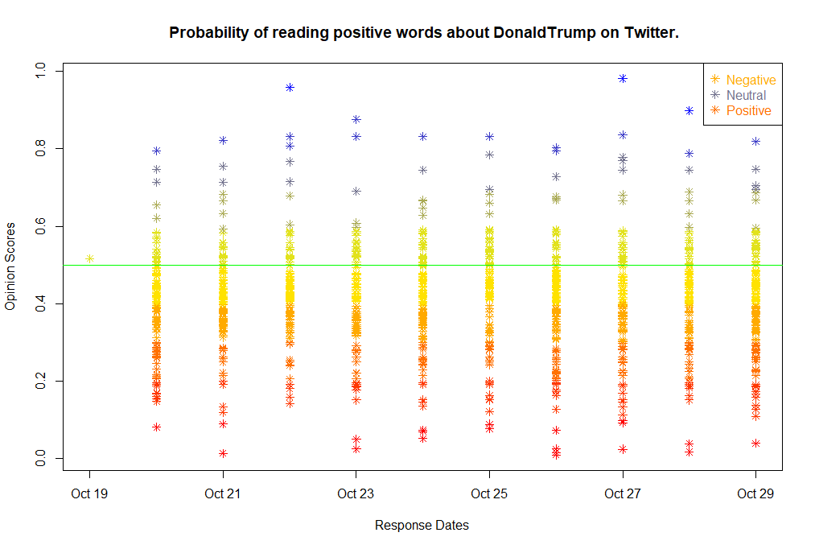
# Graph for Donald Trump

Slide 26
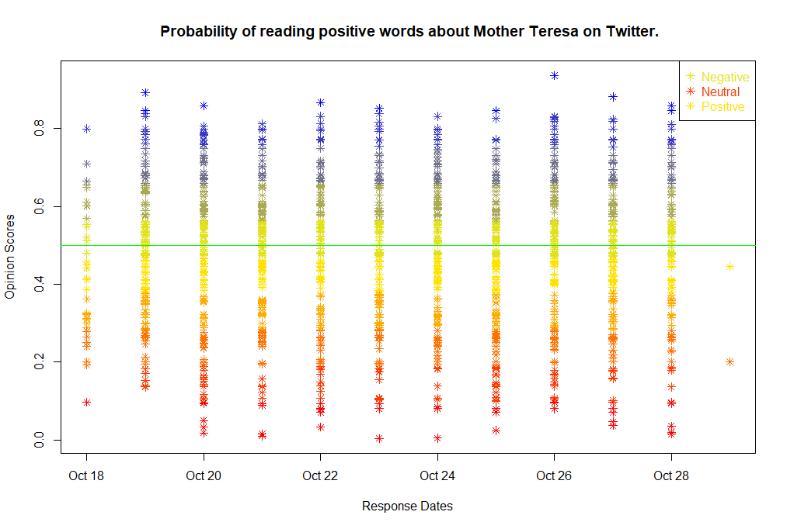
# Graph for Mother Teresa

Slide 27
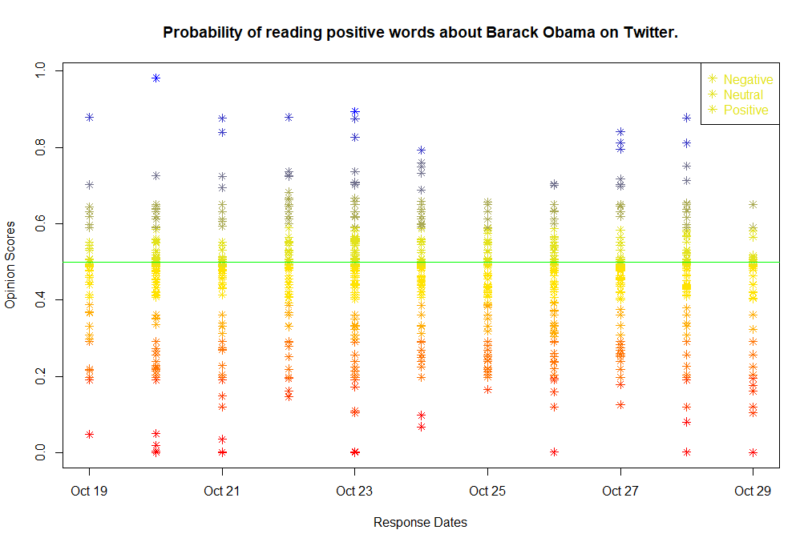
# Graph for Barack Obama

